Slide 1
High School Community of Practice #2 February 15, 2017
PBIS
Appetizer
Implicit Bias
Entrée
Addressing Discipline Disproportionality
(5 point
multi-component approach)
Dessert
PBIS Cultural Responsiveness
Field Guide
Serving Up
Collaborative Dialogue
Notes:
generate input,
share knowledge,
stimulate innovative thinking,
explore issues and action possibilities together,
encourage new ways of thinking,
create new possibilities, and
Develop stronger partnerships

Slide 2
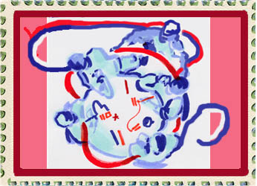
PBIS
Today’s Conversation Special
Enables us to:
Learn from each other
Share own thoughts and feelings
Plan together
Co-create
Allows “Cross-Pollination” for:
Relationship development
Idea sharing
Meaningful dialogue
Notes:
Purpose:
To generate input, share knowledge, stimulate innovative thinking, and explore action possibilities.
Exploring issues together encourages new ways of thinking and a shift in perspective creates new possibilities.

Slide 3
PBIS
Dining
Etiquette

Slide 4
PBIS
Dining
Etiquette

Slide 5
PBIS
MEET YOUR DINING PARTNERS
Find someone at the table who:
Attended the 2nd Annual HSPBIS Symposium
Did not attend the 2nd Annual HSPBIS Symposium
Is at a school site or district exploring PBIS implementation
Is at a school site or district that has been implementing PBIS implementation for one to three year
Is at a school site or district that has been implementing PBIS for more than three years
Will be traveling out-of-state for spring break
Notes:
There will be an opportunity to move to another table and answer each question during your dining experience.

Slide 6
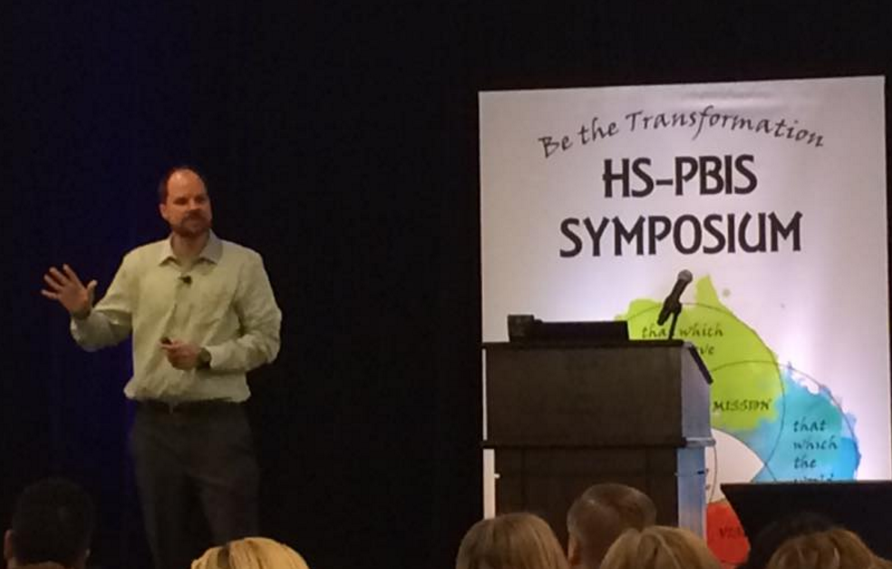
Implicit Bias
PBIS
Appetizer
What did you notice about completing the activity?
How might patterns of responses on this activity relate to real world interactions?
What is implicit bias?
What are some FAST and SLOW decisions we make on a daily basis in our high school?
Notes:
There will be an opportunity to move to another table and answer each question during your dining experience.

Slide 7
PBIS
MEET YOUR DINING PARTNERS
Find someone at the table who:
Attended the 2nd Annual HSPBIS Symposium
Did not attend the 2nd Annual HSPBIS Symposium
Is at a school site or district exploring PBIS implementation
Is at a school site or district that has been implementing PBIS implementation for one to three year
Is at a school site or district that has been implementing PBIS for more than three years
Will be traveling out-of-state for spring break
Notes:
There will be an opportunity to move to another table and answer each question during your dining experience.

Slide 8
PBIS
Implicit Bias
Notes:
Break

Slide 9
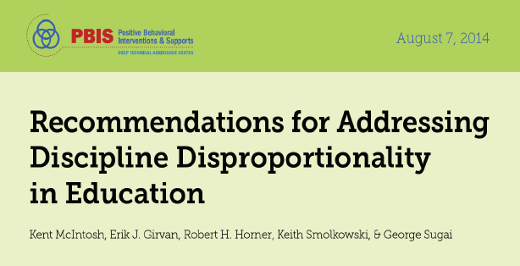
Entree
What stood out for you?
Use Effective Instruction To Reduce the Achievement Gap
Implement SWPBS To Build A Foundation of Prevention
Collect, Use & Report Disaggregated Discipline
Develop Policies for Accountability for Disciplinary Equity
Teach Neutralizing Routines for Vulnerable Decision Points
Notes:
Watch video,
Read each section before responding to question – 10 minutes – move to review – new question – 5 table hops

Slide 10
PBIS
MEET YOUR DINING PARTNERS
Find someone at the table who:
Attended the 2nd Annual HSPBIS Symposium
Did not attend the 2nd Annual HSPBIS Symposium
Is at a school site or district exploring PBIS implementation
Is at a school site or district that has been implementing PBIS implementation for one to three year
Is at a school site or district that has been implementing PBIS for more than three years
Will be traveling out-of-state for spring break
Notes:
There will be an opportunity to move to another table and answer each question during your dining experience.

Slide 11
PBIS
Discipline Disproportionality
Notes:
Lunch

Slide 12
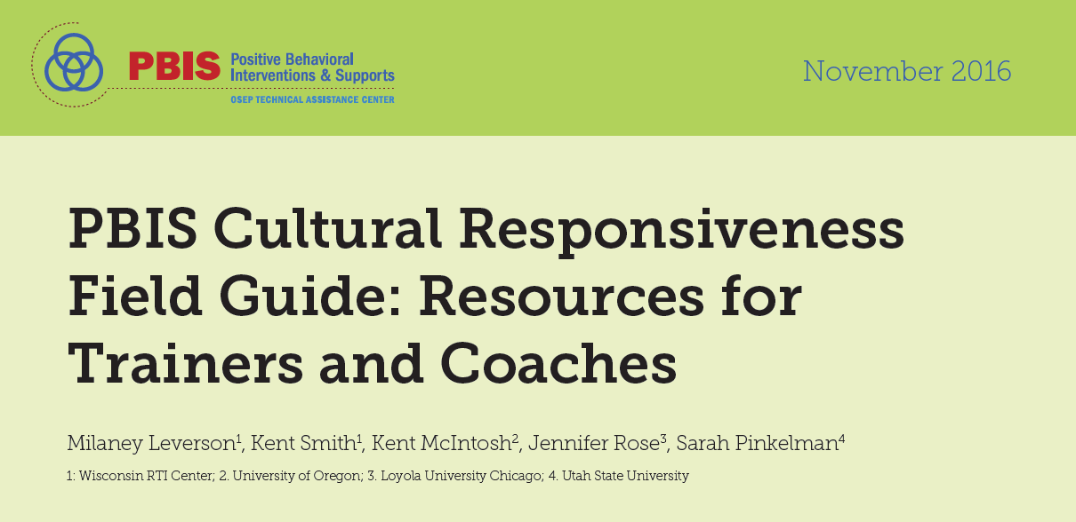
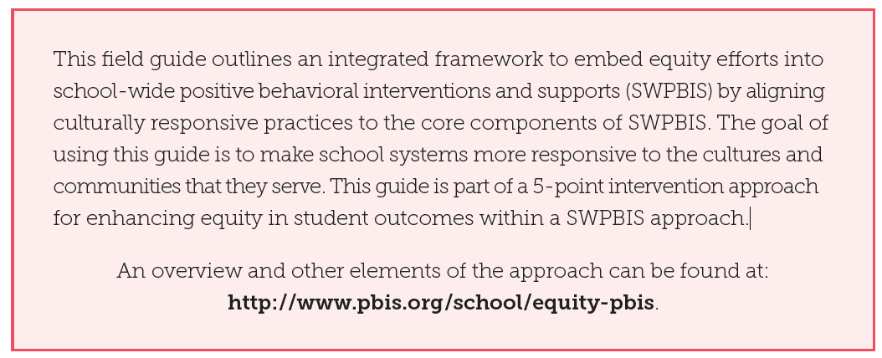
Dessert
What information is important for
High School and why?
Section 1: Identify Awareness
Section 2: TFI Cultural Responsiveness Companion
Appendices
Notes:
Watch video,
Read each section before responding to question – 10 minutes – move to review – new question – 3 table hops

Slide 13
PBIS
MEET YOUR DINING PARTNERS
Find someone at the table who:
Attended the 2nd Annual HSPBIS Symposium
Did not attend the 2nd Annual HSPBIS Symposium
Is at a school site or district exploring PBIS implementation
Is at a school site or district that has been implementing PBIS implementation for one to three year
Is at a school site or district that has been implementing PBIS for more than three years
Will be traveling out-of-state for spring break
Notes:
There will be an opportunity to move to another table and answer each question during your dining experience.

Slide 14
PBIS
Cultural
Responsiveness
Notes:
Closing and Reflection

Slide 15
COP#3
March 29, 2017
Center on Adolescent Research in Schools (CARS)
Secondary Classroom Practices: Prevention and Response Practices
Active Supervision, Precorrections and De-escalation Strategies
COP#4
April 26, 2017
LIVE WEBINAR with Jessica Swain-Bradway
Problem Solving and Decision Making Teams
Tiered Fidelity Inventory - EVALUATION

